Slide 1


GROWTH MINDSET IN ACTION

Slide 2


Slide 3

Muller-Lyer Illusion

Slide 4
Müller-Lyer Illusion
1. Perception ≠ Reality
Just because something looks true doesn’t mean it is true.
Mindset shift: “Don’t blindly trust first impressions — question, verify, think deeper.”
2. Biases Influence Judgments
Our brains take shortcuts → often leading to errors.
Mindset shift: “I may carry hidden biases about myself and others. To grow, I must challenge them.”
In teamwork: Don’t judge a classmate by their quietness or background — they may have hidden talents.

Slide 5


Slide 6
1. The 40% Rule Challenge (Best Fit)
When you think you’re done, you’re only at 40% of your potential.
Comfort zone vs. real capability
2. Cookie Jar Reflection
“Cookie Jar” — dipping into past wins when times get tough.
3. Accountability Mirror
1 “truth” (something holding you back).
1 “power word” (your strength).
Knowing is not enough → we must practice new ways of thinking
.

Slide 7
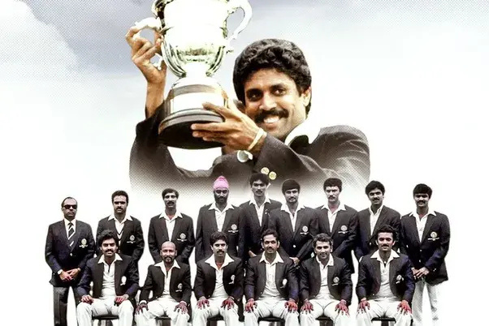
1983 World Cup

Slide 8
In 1983, nobody believed India could win the World Cup.
Bookies in London gave India 66:1 odds (illusion = “India is weak”).
West Indies had already won 2 World Cups and were called “invincible.”
Even Indian players admitted they felt like underdogs.
Kapil Dev’s 175 not out vs Zimbabwe changed momentum → showed the team’s real strength.
In the final, India scored only 183 runs (seemed too small, like the “shorter line”).
Everyone thought West Indies would easily chase it.
But India bowled them out for 140 and became champions
“The world saw India as the shorter line — but in reality, they were equal, even stronger.”

Slide 9

SHARK IN OPEN OCEAN, THE VERY SAME SPECIES CAN GROW TO 12 FEET OR MORE
SHARK KEPT IN A SMALL AQUARIUM GROWS ONLY ABOUT 6–8 FEET

Slide 10

WHAT ARE THE SITUATIONS IN COLLEGE OR LIFE AFTER +1 AND + 2 THAT MAKE YOU FEEL STRESSED OR DOUBTFUL ABOUT YOURSELF

Slide 11

GOAL PRACTICE

Slide 12
GOAL PRACTICE
Example: I’ll meditate in my room for 10 minutes at 8 AM every day by sitting quietly, focusing on breathing .
Who: Me
What: Meditate for 10 minutes
Where: In my room
Why: To reduce stress and stay focused
When: 5 AM every day
How: By sitting quietly, focusing on breathing

Slide 13
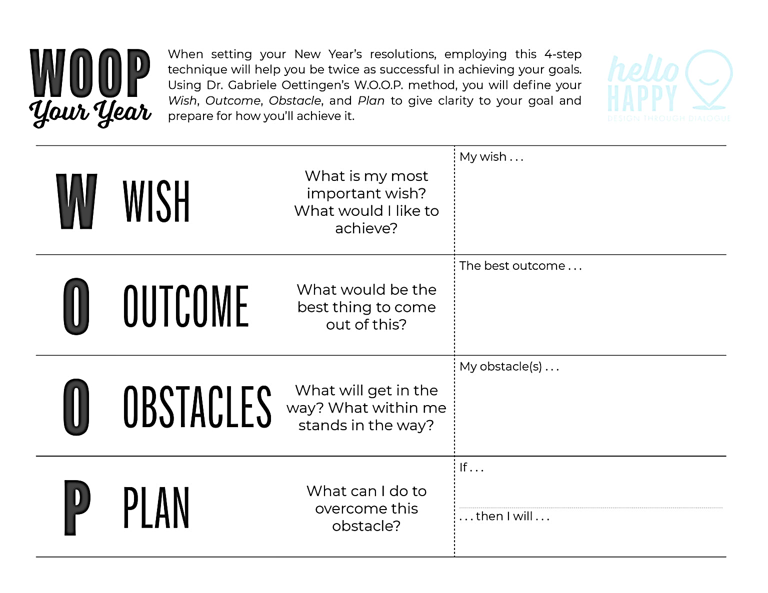
WOOP

Slide 14
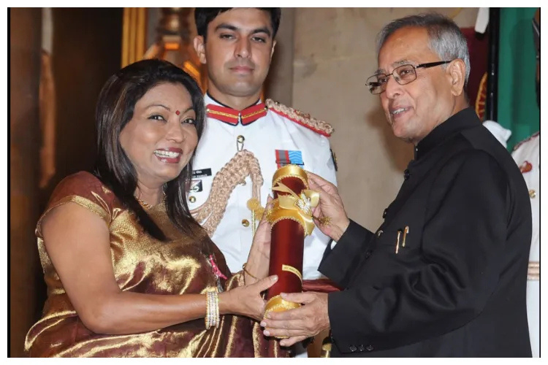
Born into poverty & caste discrimination → Felt hopeless → even attempted suicide.
Restarted at 16 → Worked as a tailor for ₹2/day → built resilience.
Saw opportunity → Took government loans → started furniture business.
Persistence & Growth Mindset → Turned around Kamani Tubes (a bankrupt company).
Today → A Padma Shri awardee, IIM governor, worth ₹2000+ crores.
KALPANA SAROJ

Slide 15
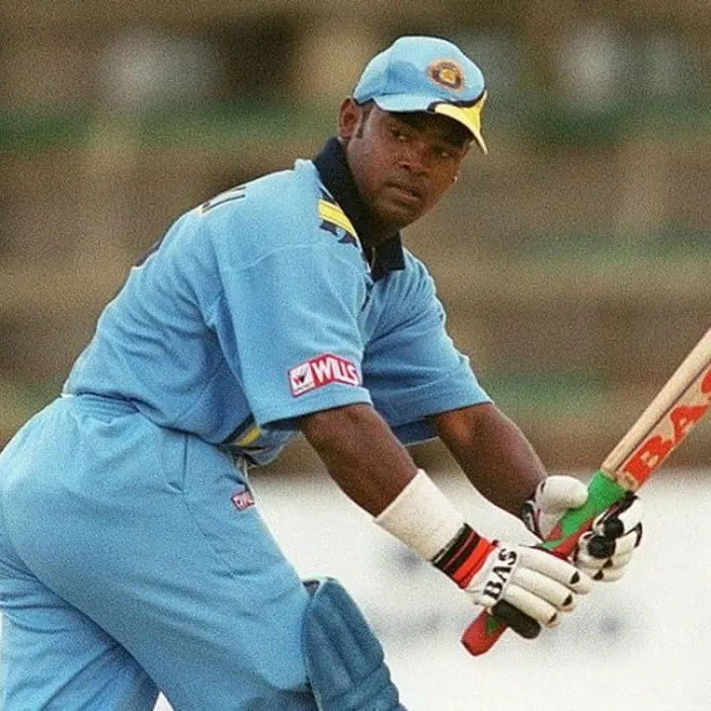
Born 1972 in Mumbai, trained under Ramakant Achrekar with Sachin.
Broke records — double centuries, highest batting average at one point.
Fame, money, and flashy lifestyle took over.
When form declined, instead of adapting or training harder, he blamed others.
Career faded while Sachin kept rising.
“Early success can make you famous, but only discipline and learning can make you unforgettable. Don’t stop when you shine — keep sharpening.”
VINOD KAMBLI

Slide 16
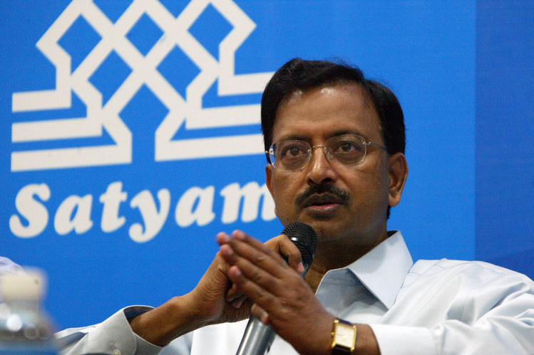
Founded Satyam in 1987; by early 2000s, it was one of India’s biggest IT companies.
Feared losing reputation and resisted transparency.
Mistake: Instead of being honest about slower growth, he faked numbers.
Impact: Company collapsed → employees, families, and investors all suffered.
Fixed Mindset vs. Growth Mindset
Raju feared admitting weakness → fixed mindset (“I must look perfect”).
A growth mindset would have said: “Slower growth is a chance to rethink, restructure, and improve.”
Student Reflection: “When I get poor marks or rejection, do I fake confidence and blame others like Raju, or do I learn and adapt?”
SATYAM COMPUTER SERVICES
“Ramalinga Raju lost everything because he wanted to look perfect instead of being real. In life, honesty + growth mindset = long-term success.

Slide 17
Cells renew in days to years (skin → 30 days, blood → 120 days, etc.)
Habits take 18–254 days depending on difficulty (average 66 days).
Skills can show visible progress in just 20 hours of focused practice (≈ 45 min/day for 1 month).
Wish: New skill or habit I want (coding, confidence, fitness).
Outcome: What will change in 30 / 60 / 120 days.
Obstacle: What may block me.
Plan: First baby step (like 20 mins/day).
Change is not instant, but it is biological and scientific. If your body renews, your mind & habits can too.

Slide 18
Positive Affirmations
I am capable of learning and growing every day.
I trust myself to handle challenges with strength.
My efforts today are shaping my brighter tomorrow.
I am improving every single day.

Slide 19

EXPLORE THE POSSIBILITIES
Email:auratheatre.edu@gmail.com
Website:www.auratels.com

